Slide 1

Cloud API development guide
Part 1
Create cloud development environment
V1.1
Author: Sheng deng/China/IBM
Feb 2014
© 2014 IBM Corporation

Slide 2
Agenda
1. Apply BlueMix account id
2. Install CF/Cloud Cli command line tool
3. Understand the BlueMix platform with general concept
4. Install Java SDK 7/8 (If you want to develop Java application on blueMix)
5. Install Eclipse Kepler
6. Install BlueMix plugin into Eclipse

Slide 3
1. Apply BlueMix account id
(1). Please follow up the below linkage for apply your BlueMix id.
https://w3-connections.ibm.com/communities/service/html/communityview?communityUuid=53a2487a-fe04-40b6-9a0b-87d932eed0df#fullpageWidgetId=Web3bae3002d6_48ba_9cb5_a6b11d4524a6&file=872b0967-0f7c-4077-ba2f-c8d3f88e1b62
(2). If you have BlueMix access issue, please update your laptop/PC hosts file from C:\Windows\System32\drivers\etc\hosts. Then please append IP address as following, after that please use 'ipconfig /flushdns' from your windows command line.(CMD tool).
9.39.222.68 ace.stage1.ng.bluemix.net
9.39.222.68 login.stage1.ng.bluemix.net
9.39.222.68 idaas.stage1.ng.bluemix.net
9.39.222.68 c2a.stage1.ng.bluemix.net
9.39.222.68 api.stage1.ng.bluemix.net
9.39.222.68 estado.stage1.ng.bluemix.net
9.39.222.68 mam.stage1.ng.bluemix.net
9.39.222.68 ace-catalog.stage1.ng.bluemix.net
9.39.222.68 mobiletemplatecatalog.stage1.ng.bluemix.net
9.39.222.68 mbaas-catalog.stage1.ng.bluemix.net
9.39.222.68 mobile.stage1.ng.bluemix.net
9.39.222.68 mamui.stage1.ng.bluemix.net
9.39.222.68 CloudCode.stage1.ng.bluemix.net
9.39.222.68 CloudCodeUI.stage1.ng.bluemix.net
9.39.222.68 loggregator.stage1.ng.bluemix.net
9.39.222.68 stage1.ng.bluemix.net
9.39.222.68 www.stage1.ng.bluemix.net (http://www.stage1.ng.bluemix.net)
9.39.222.68 uaa.stage1.ng.bluemix.net
9.39.222.68 mam.stage1.ng.bluemix.net
You can double check details from China GDC AIS Cloud API community,
https://w3-connections.ibm.com/forums/html/topic?id=fad747fd-c8a8-4af2-a79a-6072af55f184
Note: after that your BlueMix access URL shall be:
https://ace.stage1.ng.bluemix.net

Slide 4
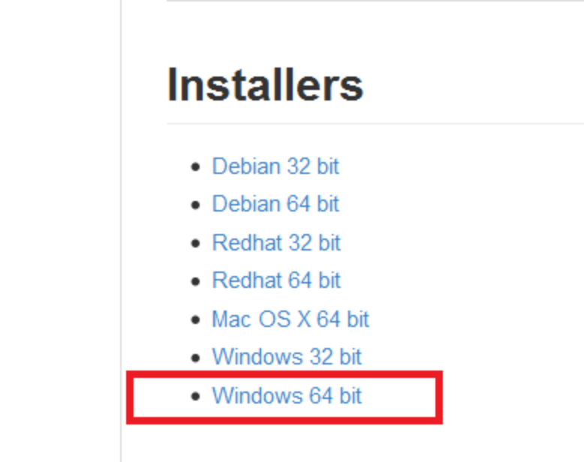
2. Install CF command line tool
(1). Download CF command line tool
Because BlueMix is based upon Cloud foudry, so you can download the CLI tool through URL below.
https://github.com/cloudfoundry/cli
Once you access the dowload page, please scroll down till the installers area. According to your operation system, you can select the proper download package, for windows 7/8, please select windows 64 bit.
(2). Unzip your installer-windows-amd64.zip, then double click 'cf_installer.exe' for install.

Slide 5
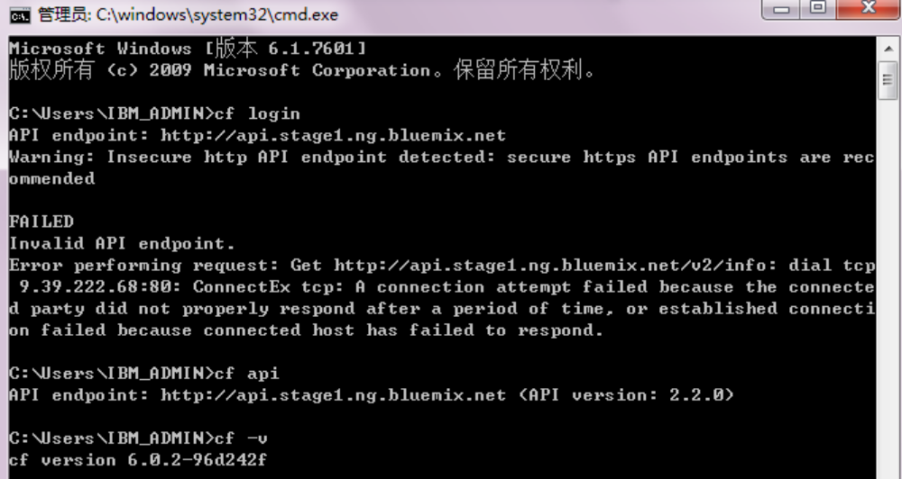
2. Install CF command line tool (cont...)
After Install you can open your command line(CMD) tool from your windows, then input the below command:
$ cf -v
If you can see the version 6.x.x, congratulations, you have successfully installed CF tool on your laptop.
For more CF command usage, please refer to below URL for learning more.
http://www.stage1.ng.bluemix.net/docs/BuildingWeb.jsp#install-cf

Slide 6
3. Understand BlueMix with general concept
BlueMix is a Cloud environment that provides the following functions:
- Enables web and mobile applications to be rapidly and incrementally composed from services.
- Delivers application changes continuously.
- Supports fit-for-purpose programming models and services.
- Embeds manageability of services and applications.
- Provides optimized and elastic workloads.
- Enable continuous availability.
What is BlueMix Application?
In the context of BlueMix, an application represents the artifact that the end developer is building.
For mobile applications, the application runs outside of the BlueMix environment,
and leverage services that are exposed to the mobile application.
What is BlueMix Service?
A service is a piece of code that BlueMix hosts. And the service offers a piece of functionality for applications to
use.BlueMix provides a set of pre-defined services that can you can use directly. For example, push notification
in a mobile application or elastic caching in a web application.
What is buildPacks?
For applications that require a PaaS environment, a buildpack is a collection of scripts that prepare
your code for execution on the target PaaS.
Refer to below for knowing BlueMix buildPacks.
http://www.stage1.ng.bluemix.net/docs/BuildPacks.jsp

Slide 7
3. Understand BlueMix with general concept
What is BlueMix Runtimes?
Runtimes in the BlueMix represent different buildpacks that are provided.
Each runtime is an application with a starter application code deployed, and a starter application
is a template so that you can use it directly with the existing buildpack from BlueMix user interface.
For more information about runtimes that BlueMix provides, refer to
http://www.stage1.ng.bluemix.net/docs/RT/Runtimes.jsp
What is Boilerplate?
A boilerplate has an associated runtime and services, and is the container of one application with multiple services.
For all available boilerplate in BlueMix.

Slide 8
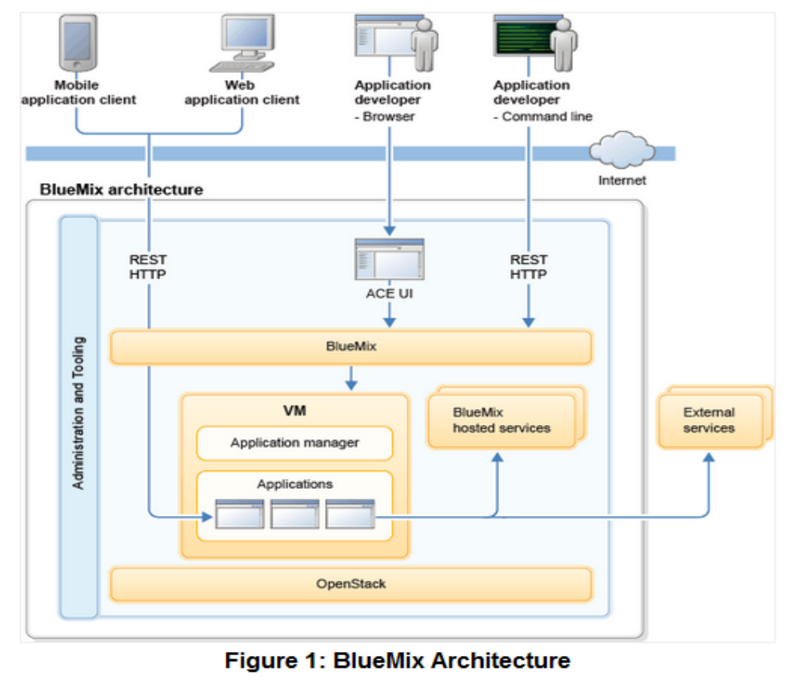
3. Understand BlueMix with general concept
What is BlueMix architecture
Refer to the URL below for knowing mor details:
https://www.stage1.ng.bluemix.net/docs/DeepDive.html

Slide 9
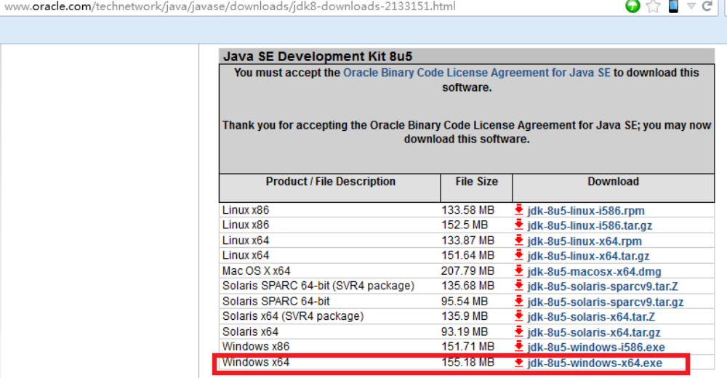
4. Install JDK8
If you are Java/J2ee developer, you are familiar with JDK installation, you can jump to next slide directly.
(1). Dowload the JDK8/JDK7 from the linkage below, for windows 7/8
(recommend to install jdk-8u5-windows-x64.exe)
http://www.oracle.com/technetwork/java/javase/downloads/jdk8-downloads-2133151.html
(2). Double click jdk-8u5-windows-x64.exe for install.

Slide 10
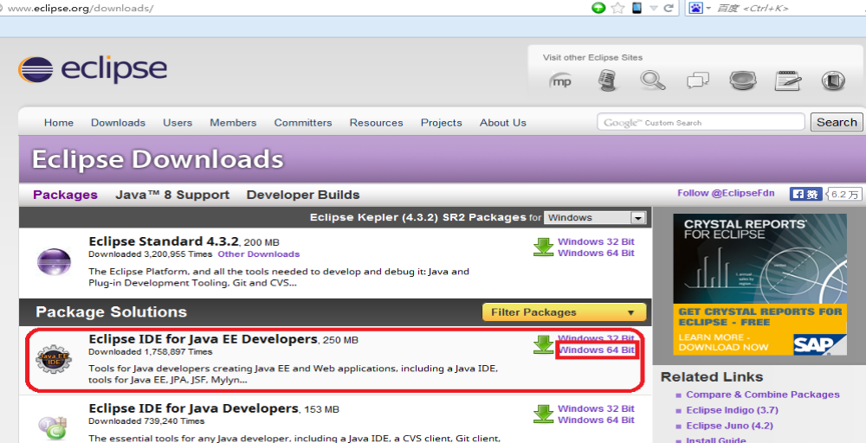
5. Install Eclipse Kepler
Eclipse is a very popular Java development toolkit, you can use the latest version Kepler as your development
environment for blueMix based Liberty Java app development.
(1). Dowload the Eclipse Kepler J2ee version from the URL below:
http://www.eclipse.org/downloads/

Slide 11
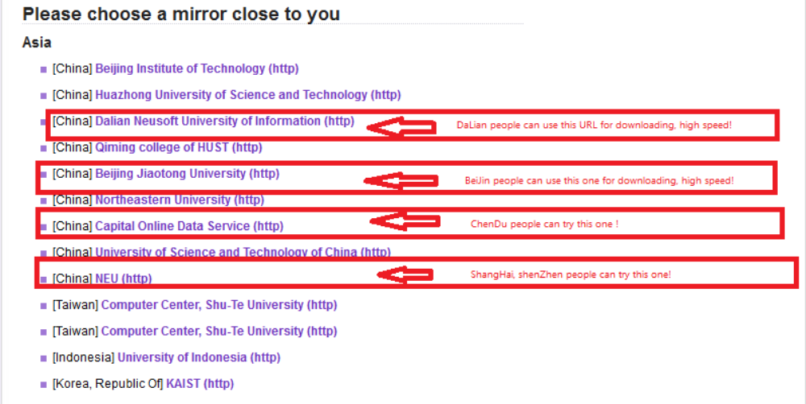
5. Install Eclipse Kepler
Please select different mirror for downloading and try to locate highest speed per your selection, you can try to
use the recommendation URL from different site/location in China. For Non-China user, please select other
mirror for downloading.

Slide 12
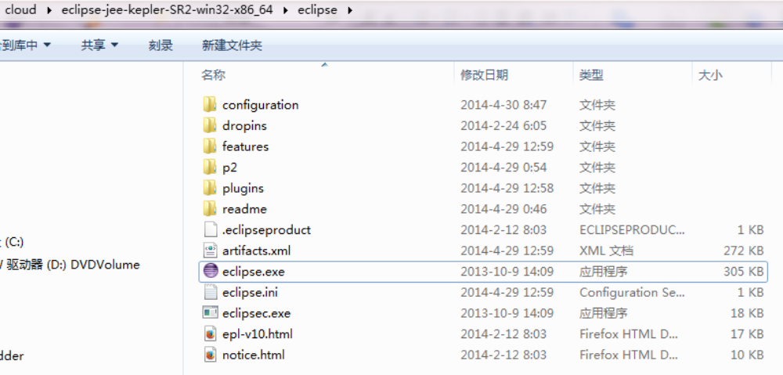
5. Install Eclipse Kepler
(2). Start eclipse IDE:
After you download the Eclipse Kepler IDE, then please unzip the eclipse-jee-kepler-SR2-win32-x86_64.zip file,
Then go to the Kepler unzip directory: eclipse-jee-kepler-SR2-win32-x86_64\eclipse, double click the eclipse
for starting your development environment.

Slide 13
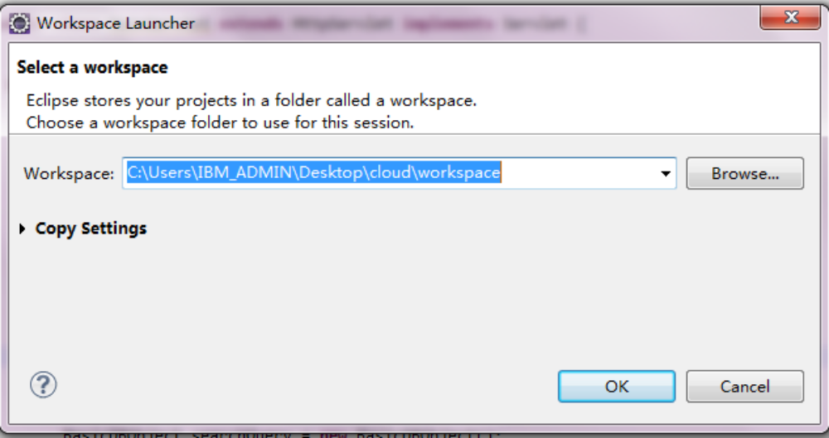
5. Install Eclipse Kepler
(3). Set proper directory as your Eclipse workspace.
(4). Refer to other linkages to learn more about Eclipse Kepler IDE, development guide and documentation.
http://help.eclipse.org/kepler/index.jsp
http://www.eclipse.org/documentation/

Slide 14
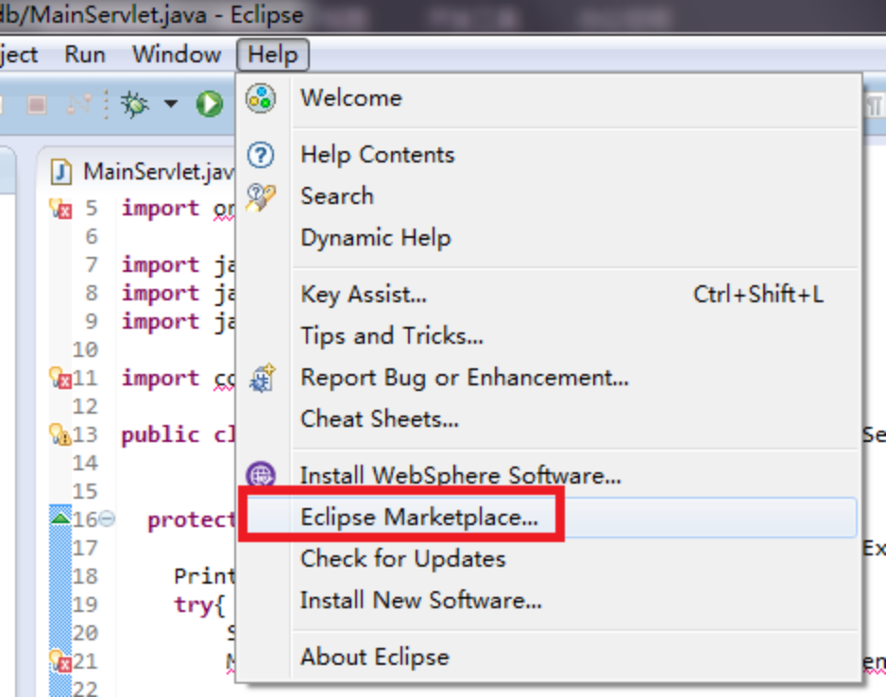
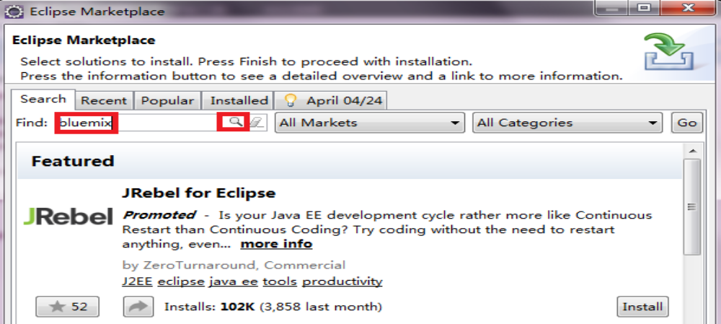
6. Install BlueMix plugin
(1). From your Kepler workspace, click 'Help' button, then select 'Eclipse Marketplace ...'
(2). Search 'BlueMix' from the search bar of the eclipse marketplace screen.

Slide 15

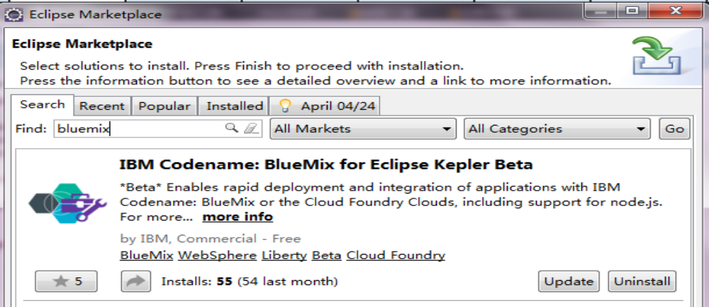
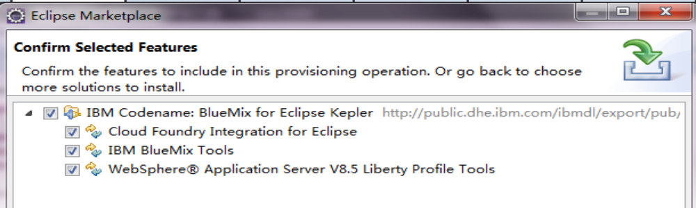
6. Install BlueMix plugin
(3). After click the mgnifying glass , you shall see the BlueMix plugin.
(4). Click 'Install' button for install the plugin, then you will see the features screen, ensure all items selected under IBM Codename: BlueMix for Eclipse Kepler. Then click 'Confirm'/'Install' button for finishing the plugin installation.

Slide 16
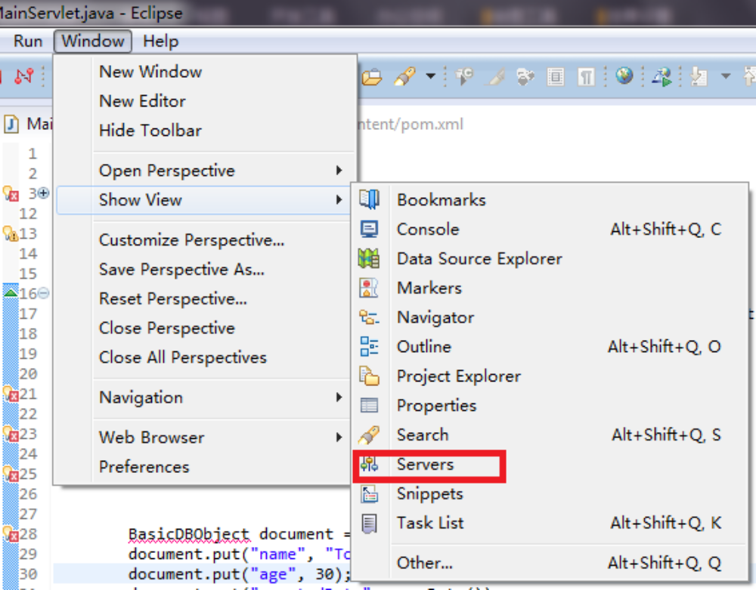
6. Install BlueMix plugin
(5). After installation, you need to restart your Eclipse to active the plugin.
(6). Create the BlueMix server instance from the Servers view.
You can create a dynamic Web project from the workspace, then you can see there is a 'Servers' view at the right bottom of the pannel. If you can't find server view, click 'Window'->'Show View'-> 'Servers' to show servers view.

Slide 17
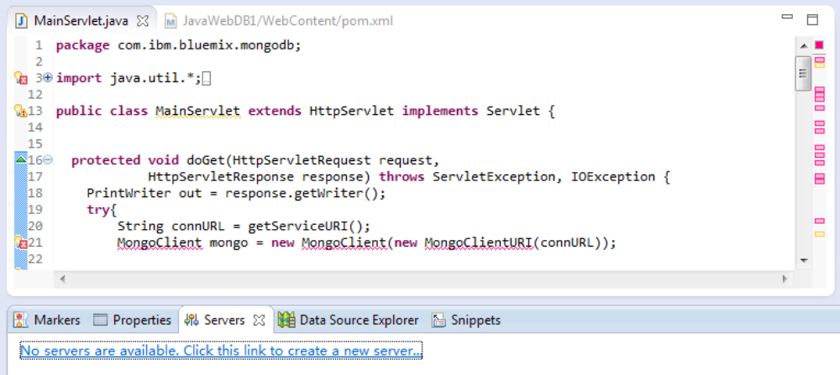
6. Install BlueMix plugin
(6). Create the BlueMix server instance from the Servers view. (cont ...)
As a developer you can treat the BlueMix as development server, so that you can click 'Create a new server'
linkage for connecting to your BlueMix cloud environment.

Slide 18
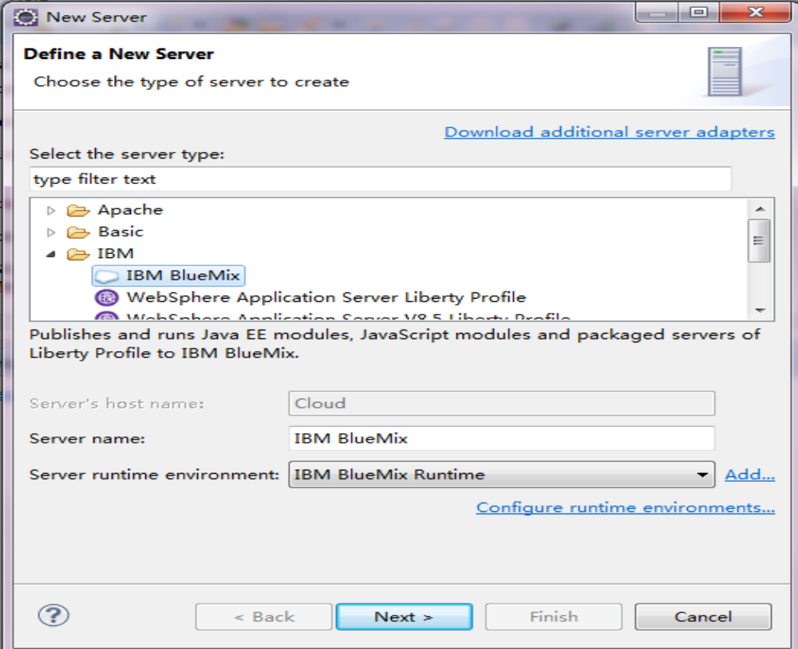
6. Install BlueMix plugin
(6). Create the BlueMix server instance from the Servers view. (cont ...)
Select 'IBM BlueMix' as server name, 'IBM BlueMix Runtime' as server runtime environment. Then click 'Next' for continue.

Slide 19
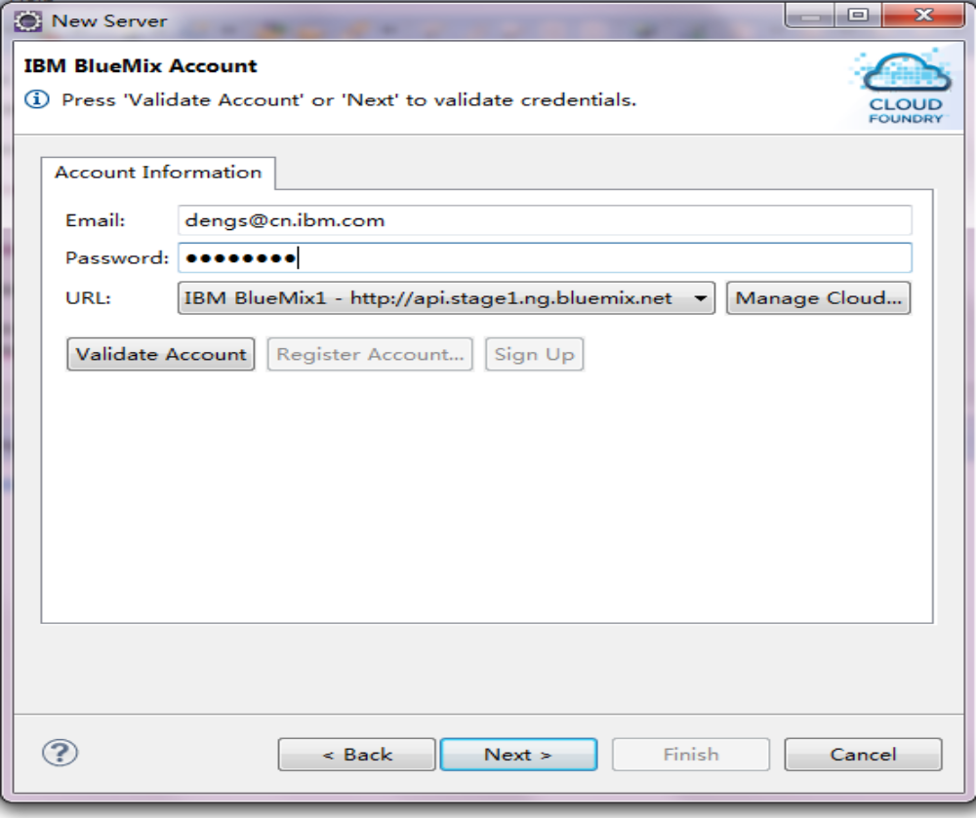
6. Install BlueMix plugin
(6). Create the BlueMix server instance from the server view. (cont ...)
Input your BlueMix id in email address, input your password, then click 'Mange cloud' button to update cloud API URL as 'http://api.stage1.ng.bluemix.net', cloud api name as 'IBM BlueMix1'. Then click 'Validate Account' button, If you are IBMer with IBM intranet ID and applied BlueMix Id.

Slide 20
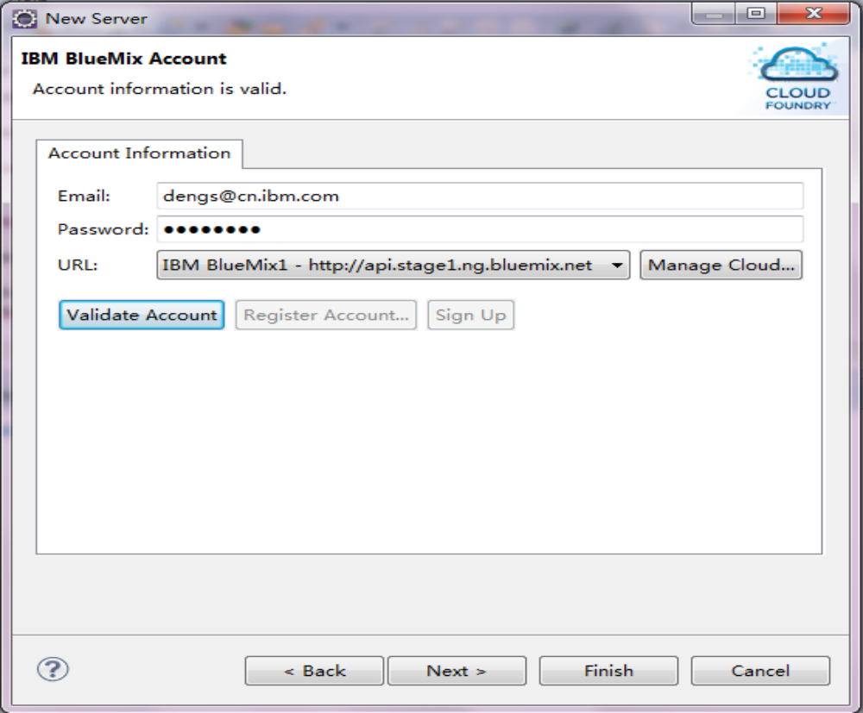
6. Install BlueMix plugin
(6). Create the BlueMix server instance from the server view. (cont ...)
If your BlueMix id, password and BlueMix API URL are valid, you will see the message 'Account information is valid' from the 'IBM BlueMix account' screen. Then, click 'Next'/'Finish' button for finishing the step.

Slide 21
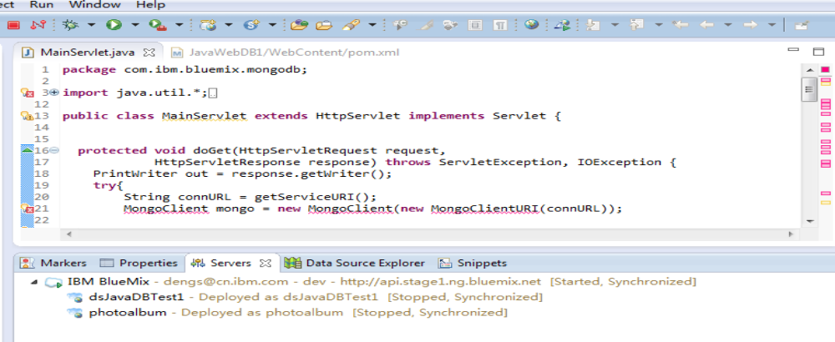
6. Install BlueMix plugin
(6). Create the BlueMix server instance from the server view. (cont ...)
View the account information and apps you have created. If you already created application through BlueMix Web UI/or by cf push command through CLI command line, you can see the applications what you created before.
For how to deploy an application on BlueMix, you can refer to the guide:
https://www.stage1.ng.bluemix.net/docs/BuildingWeb.jsp
https://www.stage1.ng.bluemix.net/docs/JavaDbBoilerplate.jsp

Slide 22
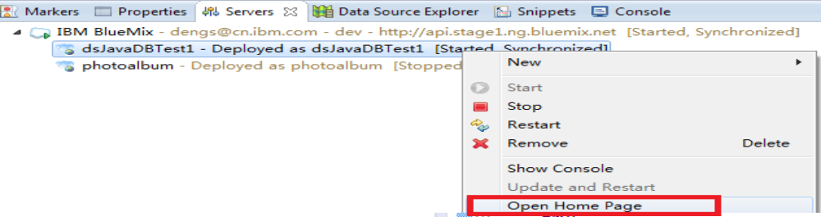
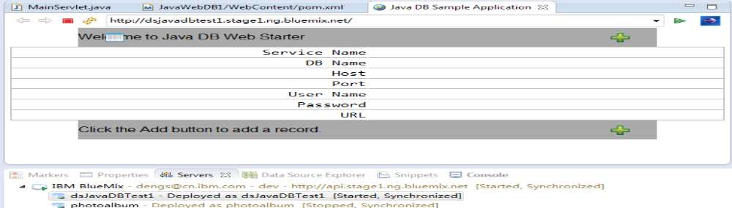
6. Install BlueMix plugin
(7). Start the application and view the application through browser. (cont...)
View the application through clicking 'Open Home Page' text icon by right clicking the application you selected from the servers view.
Eclipse provides a browser view for your review the running web applications.

Slide 23
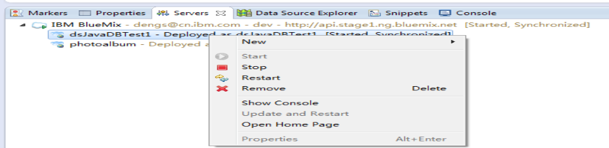
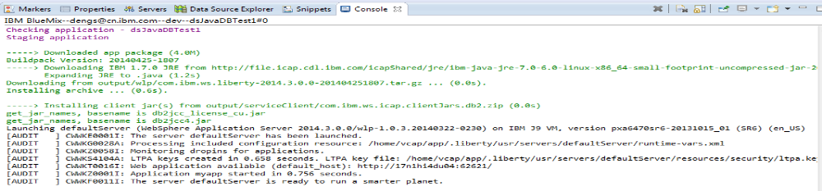
6. Install BlueMix plugin
(7). Start the application and view the application through browser.
You can follow up the guide to create a Java DB application, even you are not Java programmer.
https://www.stage1.ng.bluemix.net/docs/JavaDbBoilerplate.jsp
Then when you work from the 'Servers' view of eclipse, you can click 'start' icon to start the application.
Meanwhile from the 'Console' view, Eclipse will display associated messages, regarding how the application
deployed on BlueMix platform.

Slide 24
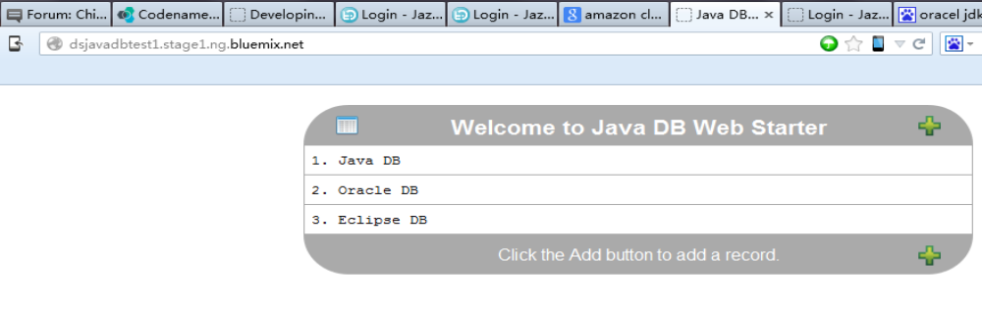
6. Install BlueMix plugin
(7). Start the application and view the application through browser. (cont...)
Copy the URL from Eclipse browser view, then paste it to firefox URL bar, then click 'enter' from key board for accessing the application, after that you can access the application from firefox/IE/Chrome.
The serial Cloud API&BlueMix development guide has been published on IBM GBS practitioner Portal, the more
is coming soon, please check China GDC AIS Cloud API community for the latest information.
https://w3-03.sso.ibm.com/services/practitionerportal/myportal/!ut/p/b1/hY7LCoMwEEW_xQ8oMxMTo8ugqKkhh
b7NRlyUYvGxKf3-RuimherALOZyLnPAQb0RnDFMuBRwBTe2r-7ePrtpbPv5dlGjELHwywrCGDXfMiqzlDiFHqijJi1
UyaXxBCmJzIpDdtJ7Qh3CUpvPbQ_gn1H4_T2ubO5Dm6DZmRBRfPoLwIr9BdxsuOQPK4I_L0ylUDOsztIeyWdgy
2m4weD6PE_0g6sgeAPJdepL/dl4/d5/L2dBISEvZ0FBIS9nQSEh/
So far you have done the BlueMix development environment setup. Please pay attention to China GDC AIS
Cloud API develoment guide part 2: develop a Java&DB application via BlueMix.
https://w3-connections.ibm.com/forums/html/topic?id=fad747fd-c8a8-4af2-a79a-6072af55f184
Thanks for exercising the development guide, wish you have better career in Cloud area!

